Slide 1
Intro to Python
Week 2

Slide 2


Slide 3


Slide 4
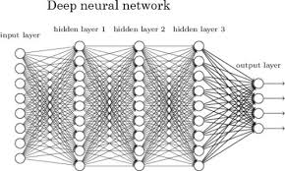


Slide 5


Slide 6
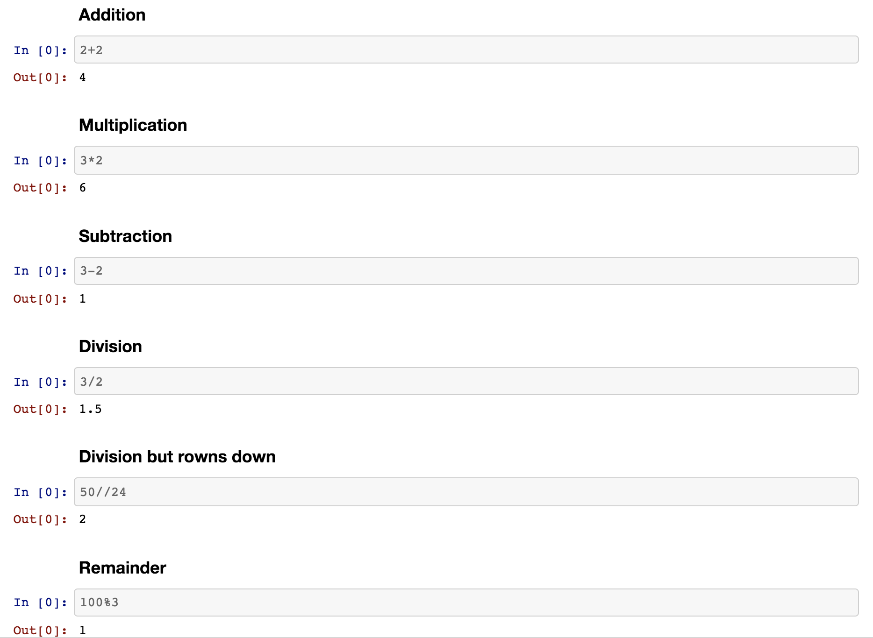

Slide 7
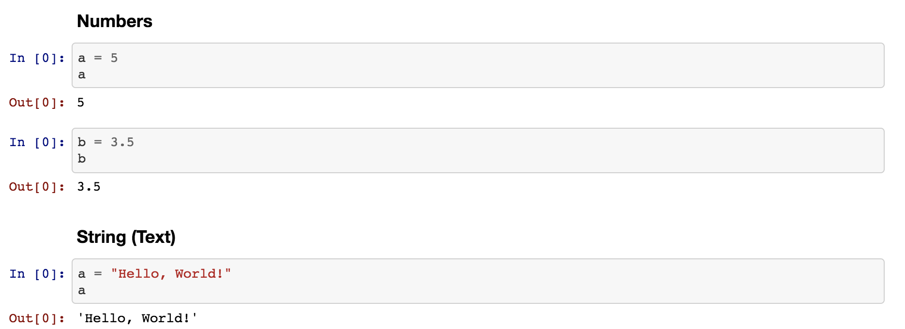

Slide 8
Data Types
Int
str
float

Slide 9
Data Types
Int
str
float
(Numbers)

Slide 10
Data Types
Int
str
(Text)
float
(Numbers)

Slide 11
